Slide 1

Module # 8
Input/Output
Dr. Friedman

Slide 2
Module # 8
Using the scan () function
Using the readline () function
Reading and Writing files (function)
Access the internet (function)
Overview
String-Manipulation functions
Introduction to plyr package – More advanced
Chapter 10
Chapter 11

Slide 3
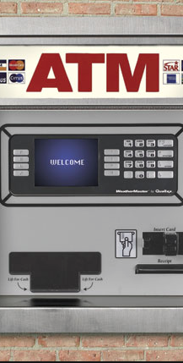
Background input/output (I/O)
Input: anything being sent or given to the machine/program
Output: anything that is returned to the user
Our textbook provides the example of ATM cash machine. -- Input >>> Reading your card, reading your request, Output>>> printing instructions on the screen, printing your receipt

Slide 4
Input in R
Normally we have been inputting out own data sets or importing our own files with file.choose()
Data can be run by prompting the user for input as well as printing to the monitor.

Slide 5
We will review few of Commands associated with input/output
> scan()
> readline()
> print()
> cat()

Slide 6
Scan()
With this function you can easily scan a file into R.
When scanning just numbers the splitting on spaces or tabs is automatic.
When scanning a mixture of characters and numbers (or just characters) the function requires a > scan(“filename.txt”, what=“”)
This tells the scan function to split the values by spaces.
You can also split each value by > scan(what=“”,sep=“/n”).
The above change to scan() allows you to split each value by row (instead of space)

Slide 7
Scan()
You can also leave the arguments blank for > scan(“”)
This will prompt the user to enter in data from his keyboard in the console.

Slide 8
Example
Here is an example of Data located at UCLA http://www.ats.ucla.edu/stat/data/scan.txt The code: x <-scan("http://www.ats.ucla.edu/stat/data/scan.txt", what = list(age = 0,name = ""))) >$age
[1] 12 24 35 20
>$name
[1] "bobby" "kate" "david" "michael"

Slide 9
Readline()
You can also read the keyboard input from the user with >readline()
>readline() is mostly used with a prompt message, for example >readline(“What is your Age: “)
This will send the given string to the console and prompt the user for input.

Slide 10
So, here is output -- Try it ☺
>fun <- function() {
ANSWER <- readline("Are you a satisfied R user? ")
if (substr(ANSWER, 1, 1) == "n")
cat("This is impossible. YOU LIED!\n")
else
cat("I knew it.\n")
} >fun()

Slide 11
Print()
Printing to the R console is a core part of a function and package, specifically when returning complicated objects.
Print can also be used to run a calculation.
For example is
>x = 2 >y = c(1,2)
> print(x^2)
[1] 4
>print(y^2)
[1] 1 4

Slide 12
Cat()
Cat() is better used when dealing with characters and strings.
It has default handling for spaces and quotation marks
> print(“abc”)
[1] “abc”
> cat(“abc\n”)
[1] abc
Remember that \n is break-line.

Slide 13
Cat()
Cat has many useful functions such as string formatting.
> x = c(5,12,13,8,88)
> cat(x,sep=c(“.”,”.”,”.”,”\n”,”\n”)
[1] 5.12.13.8
[2] 88

Slide 14
Reading and Writing files
read.table() is often more useful than scan() because data files often have a mixture of numeric and character data. Use the Sep=“” function to set your separator variable.
Read.table() also has ,header=TRUE, argument that allows you to enter the fire row as header in your data frame automatically.

Slide 15
Reading and Writing files
An example if we have a 5x3 matrix file
We could use >scan()
>x = matrixscan(“x”,nrow=5,byrow=TRUE)
But it is better to use read.matrix and read.table
>read.matrix = function(filename) {as.matrix(read.table(filename))}

Slide 16
readLines()
When reading text from a file you can also use the >readLines() function that will return the read file all at once.
The example file we will use is a file called z0 which has these values
John 25
Mary 28
Jim 19
When we want to read a file line by line we need to create a connection to the file in R.
John | 25
Mary | 28
Jim | 19

Slide 17
File Connections
A connection is essentially a file object that holds the file in an object that allows you to call various functions on the file.
You can do this by calling file() or url()
If we have a file called z0.txt
>c = file(“z0”,”r”)

Slide 18
File Connections
In the previous example using >readLines() would return us the entire file,
However using this new method file() allows us to call and return the file piece by piece.
>c = file(“z0”,”r”)
>readLines(c,n=1)
[1] “John 25”
readLines(c,n=1)
[2] “Mary 28”

Slide 19
File Connections
In this case “n=X” is the increment. This allows us to read the file line by line and when it reaches the end of the file it will return

Slide 20
File Connections
To do this we must use the >seek() function.
>c = file(“z0”,”r”)
readLines(c, n=2)
[1] “John 25” “Mary 28”
>seek(con=c, where=0)
[1] 16
> readLines(c,n=1)
[1] “John 25”

Slide 21
Seek()
The seek() function tells where=XX argument file pointer is. It will tell us how many characters from the start of the file.
Where=0 means that we wish to position the file pointer to start with zero characters from the start of the file. (directly at the beginning)
The return we say was [1] 16, this value is telling us what character the pointer was on before seeking. (this includes white spaces)

Slide 22
Reading from URL
R will allow us to connect and download files from URL, read.table() and scan() both accept these inputs as valid.
The example the book gives is downloading a echocardiogram data set from a university website. In this example, it uses paste function.
> x = http://archive.ics.uci.edu/ml/machine-learning-databases/
> x = paste(x, “echocardiogram/echocardiogram.data”,set=“”)
> y = read.csv(x)

Slide 23
Writing to a file
>write.table() is a commonly used function for writing a file.
> kids = c(“Jack”, “Jill”)
> ages = c(12,10)
> d = data.frame(kids,ages,stringsAsFactors=FALSE)
> write.tables(d,”kds”)
This will create a file called kids using the d dataframe.

Slide 24
Writing with Cat()
The cat() function we used before can also be used to create a file as well, one part at a time.
>cat(“abc\n”, file = “u”)
>cat(“de\n”file=“u”,append=TRUE)
Cat() will save the file after each command, thus the append=TRUE command is needed to add lines instead of overwritting.

Slide 25
Chapter 11 String Manipulation
String is traditionally a sequence of characters, either as a some kind of variable. A string is generally understood as a data type and is often implemented as an array of bytes (or words) that stores a sequence of elements, typically characters, using some character encoding.
String manipulation, according to Bal and Grune (Programming language essentials -1994), is the action of the fundamental operations on strings, including their creation, concatenation, the extraction of string segments, string matching, their comparison, discovering their length, replacing substrings by other strings, storage, and input/output..

Slide 26
Chapter 11 In R, string manipulation
While we have been talking about reading and writing files involving numeric data and character data. We may need to manipulate character data (strings).
R has many tools to allow you to manipulate strings and characters.

Slide 27
Under String manipulation
In this two types of strings:
i. ignore.case(string) This function specifies that a pattern should ignore the case of matches. if FALSE, the pattern matching is case sensitive and if TRUE, case is ignored during matching.
>pattern <- "a.b"
>strings <- c(”ABB”, ”aaB”, ”aab”)
>str_detect(strings, pattern)
>str_detect(strings, ignore.case(pattern))

Slide 28
paste()
The function paste converts its arguments (via as.character) to character strings, and concatenate them (separating them by the string given by sep). If the arguments are vectors, they are concatenated term-by-term to give a character vector result. Vector arguments are recycled as needed, with zero-length arguments being recycled to "".
>paste(LETTERS) [1] "A" "B" "C" "D" "E" "F" "G" "H" "I" "J" "K" "L" "M" "N" "O" "P" "Q" "R" "S" "T" "U" "V" "W" "X" "Y" "Z”
> paste (c("a", "b", "c"), 1:5, sep="")
[1] "a1" "b2" "c3" "a4" "b5"

Slide 29
grep()
If you are looking to a specific set of characters in a string (or elements in a vector) you can do that with grep()
>x <- c("16_24cat", "25_34cat", "35_44catch", "45_54Cat", "55_104fat") >grep(pattern = "cat", x = x) [1] 1 2 3 >grep("cat$", x, ignore.case = T) >[1] 1 2 4

Slide 30
nchar()
nchar() function determines the size of each elements of an character vector. nzchar() tests whether elements of a character vector are non-empty strings.
>nchar(x, type = "chars", allowNA = FALSE)
>nzchar(x) x: character vector
type: bytes, chars or width
allowNA: logical: should NA be returned for invalid multibyte strings or "bytes"-encoded strings (rather than throwing an error)? > x <- c("red","greed","blue")
> nchar(x)
[1] 3 5 4
> nzchar(x)
[1] TRUE TRUE TRUE
> x <- "red"
> nchar(x)
[1] 3

Slide 31
sprintf()
Allows you to format a string
> i = 8
> s = sprintf(“the square of %d is %d”,i,i^2)
>s
[1] “the square of 8 is 64”
The % sign tells the computer to look for a value to place into the string (at the end of the function) and the d (in %d) says it’s an integer

Slide 32
strsplit()
Strsplit() allows us to split a string into values. This is very useful with date math or time math.
> strsplit(“6-16-2011”, split=“-”)
[[1]]
[1] “6” “16” “2011”

Slide 33
R has many tools
We covered a lot of tools today and not all of them will be useful to your needs, however being aware of these tools allows you to solve any problems you encounter while creating your package.

Slide 34
plyr package in R
Not discussed in our textbook

Slide 35
plyr package
It one of the top most used packages.
This package is immense in its capabilities were will be focusing on a quick overview and then its application to this assignment.
Plyr package allows to Split data, and Run functions on that split section, then Combine it back with the original data set.

Slide 36
Why plyr?
The syntax is the same across all its functions, instead of having to load 5 packages for each data type.
This makes plyr package the best choice !! ☺.
These functions inside the plyr are mostly focused around “apply” functions (which is basically a for loop)

Slide 37
Control structures
Comparison Operators
equal: ==
not equal: !=
greater/less than: > <
greater/less than or equal: >= <=
Logical Operators
and: &
or: |
not: !

Slide 38
If statements
If statements operate on length-one logical vectors.
Syntax
if(cond1=true) { cmd1 } else { cmd2 }
Example
if(1==0) {
print(1)
} else {
print(2)
}
[1] 2

Slide 39
Loops
The most commonly used loop structures in R are for, while and apply loops. Less common are repeat loops. The break function is used to break out of loops, and next halts the processing of the current iteration and advances the looping index.
For loops are controlled by a looping vector. In every iteration of the loop one value in the looping vector is assigned to a variable that can be used in the statements of the body of the loop.
Usually, the number of loop iterations is defined by the number of values stored in the looping vector and they are processed in the same order as they are stored in the looping vector.

Slide 40
Example for(variable in sequence) { statements }
>mydf <- iris
>myve <- NULL # Creates empty storage container
for(i in seq(along=mydf[,1])) {
myve <- c(myve, mean(as.numeric(mydf[i, 1:3]))) # Note: inject approach is much faster than append with 'c'. See below for details.
}
>myve
[1] 3.333333 3.100000 3.066667 3.066667 3.333333 3.666667 3.133333 3.300000
[9] 2.900000 3.166667 3.533333 3.266667 3.066667 2.800000 3.666667 3.866667

Slide 41
Example of condition
>x <- 1:10
>z <- NULL
for(i in seq(along=x)) {
if(x[i] < 5) {
z <- c(z, x[i] - 1)
} else {
z <- c(z, x[i] / x[i])
}
}
>z
[1] 0 1 2 3 1 1 1 1 1 1

Slide 42
plyr function prototype
“X,Y,PLY”()
d = dataframe, a = array, l (L) = list
For X you put the format of your data type
For Y you put the format you wish to export so for a data.frame to a list you would put
>dlply()
For array to dataframe you would put
>adply()

Slide 43
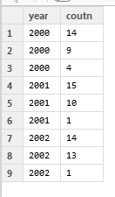
plyr example
Create a data set
> d = data.frame(year=rep(2000:2002, each = 3),count = round(runif(9,0,20))) this creates a data set that looks like this

Slide 44


plyr example
Lets say we wanted to create a mean for each year as well as a total for each year,
>ddply(d,”year”,summarise,mean.count = mean(count))
>ddply(d,”year”,summarise,total.count = sum(count))

Slide 45
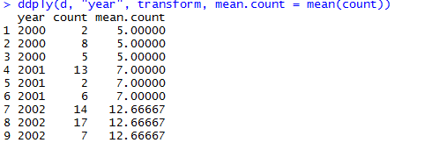
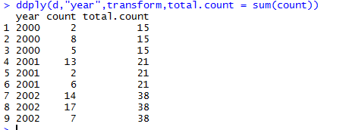
plyr Example
Lets to the same commands but displayed against the raw table (not summarized)
>ddply(d,”year”,transform,mean.count = mean(count))
>ddply(d,”year”,transform,total.count =sum(count))

Slide 46
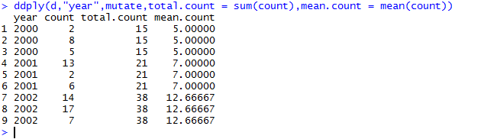
plyr Example
If you wanted to do both count and sum at the same time against the raw table, you can use the “mutate” argument.
>ddply(d,”year”,mutate,total.count = sum(count),mean.count = mean(count))

Slide 47
Credit for slide Information
https://www.rdocumentation.org/packages/plyr/versions/1.8.4
The author is Hadley Wickam.
My presentation is based on Wickam’s notes.

